Slide 1

DriverPass System Analysis
Ryan Jones
Notes:
[No speaker notes required for this slide.]

Slide 2

System Requirements
Students must be able to book a lesson
Students must be able to take practice exams
TLS encryption for data in transit
The system must be performant
Notes:
[In your speaker notes, include an explanation of the different requirements you determined for DriverPass’s system. What are the functional requirements you selected to describe? What are the nonfunctional requirements you selected to describe? Be sure to explain how these requirements meet DriverPass’s needs.]

Slide 3
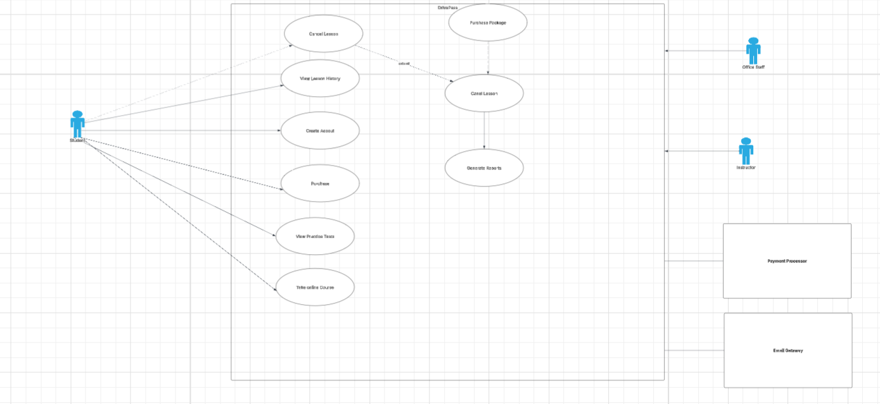
Use Case Diagram
Notes:
[Explain your diagram. Who are the different actors in the system? What are the different use cases? How did you account for DriverPass’s needs in your design? In your explanation, keep your audience in mind. Avoid the use of terms like “actors” and “use cases” in your explanation.]

Slide 4
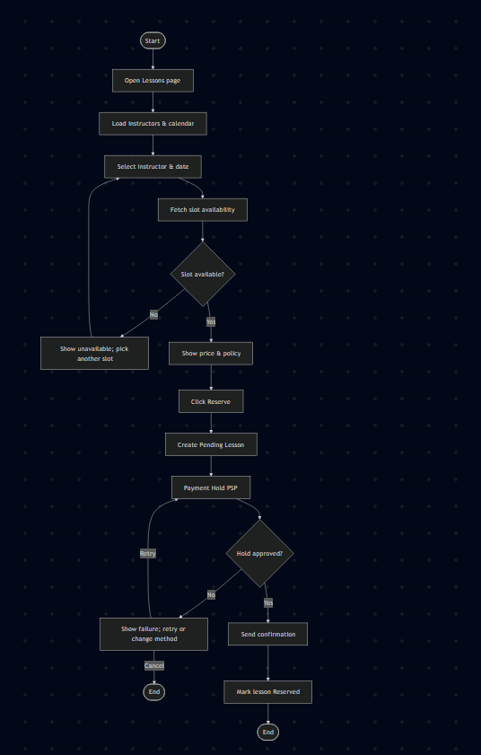
Activity Diagram
[Insert one of your activity diagrams here.]
Notes:
[Explain your diagram. Which use case are you breaking down? What are the steps for this use case? How did you account for DriverPass’s needs in your design? In your explanation, keep your audience in mind. Avoid the use of technical terms such as “nodes,” “control flows,” and so on.]

Slide 5
Security
TLS for data in transit
Passwords are hashed before being written to the database
Role Based Access control
Nightly Backups
Limited password retries
Notes:
[How did you consider security in your design? In your explanation, keep your audience in mind by avoiding the use of technical terms.]

Slide 6
System Limitations
A programmer is required to create new packages
Manual deconflicting of schedules
Basic Reporting
Relies on external services for payments
Notes:
[What are the limitations of your design? In your explanation, keep your audience in mind by avoiding the use of technical terms.]

